Slide 1

Advanced course
Lesson 35
DIY coures（13）
Fingertip music
YahBoom Croco:Kit tutorial

Slide 2

Advanced course
Content
Part1
Part 2
Part3
Part 4
Part 5
Learning goals
Preparation
Connection
Search for blocks
Combine blocks
YahBoom Croco:Kit tutorial

Slide 3
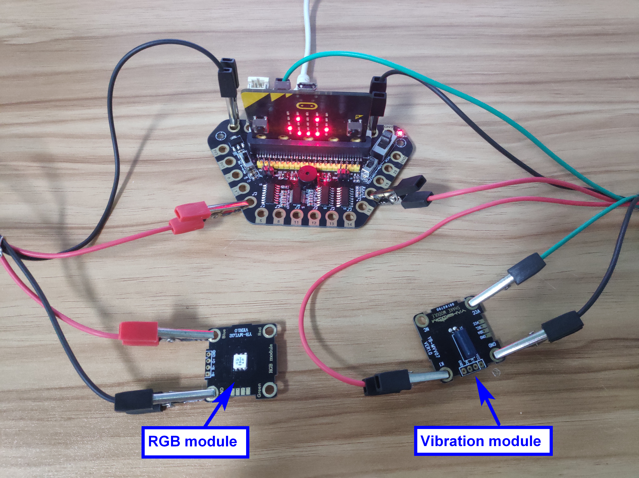
Advanced course
Part 1
Learning goals
After downloading the program, when we gently use the finger to gently shake the sensor on the vibration module, it will detect the vibration. At this time, the micro:bit dot matrix will display music pattern and flash three times, and then the buzzer will play music, the blue RGB light will flash during music playing.
YahBoom Croco:Kit tutorial

Slide 4
Advanced course
Part 2
Hardware:
● 1 X Micro:bit Board
● 1 X Micro USB Cable
● 1 X Diamond breakout
● 3 X Alligator clip
● 2 X RGB light module
● 1 X Vibration module
● 1 X PC
Preparation
Mode 1 online programming: First, we need to connect the micro:bit to the computer by USB cable. The computer will pop up a USB flash drive and click on the URL in the USB flash drive: http://microbit.org/ to enter the programming interface. Add the Yahboom package: https://github.com/lzty634158/Croco-Kit to program.
Mode 2 offline programming: We need to open the offline programming software. After the installation is complete, enter the programming interface, click【New Project】, add Yahboom package: https://github.com/lzty634158/Croco-Kit , you can program.
YahBoom Croco:Kit tutorial

Slide 5
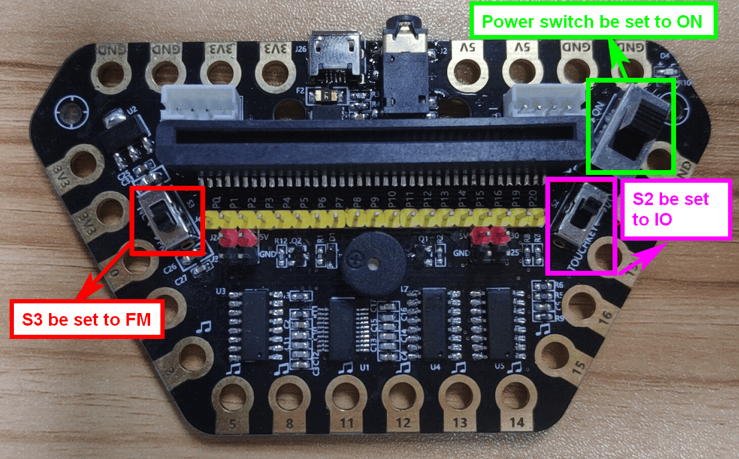
Advanced course
Part 2
Preparation
! ! !Note: S1 be set to the ON, S2 be set to the IO, and S3 to the FM.
YahBoom Croco:Kit tutorial

Slide 6
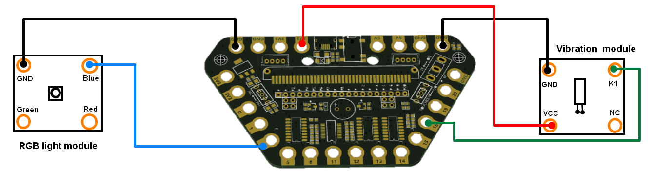
Advanced course
Part 3
Expansion board | RGB light module | Vibration module
P2 | Blue
P16 |  | K1
3.3V |  | VCC
GND | GND | GND
Connection
YahBoom Croco:Kit tutorial

Slide 7
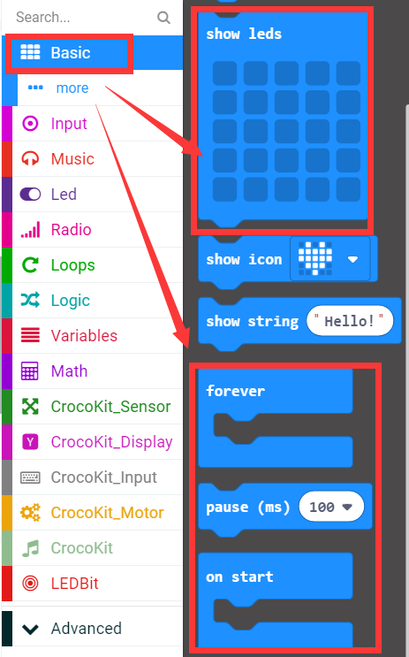
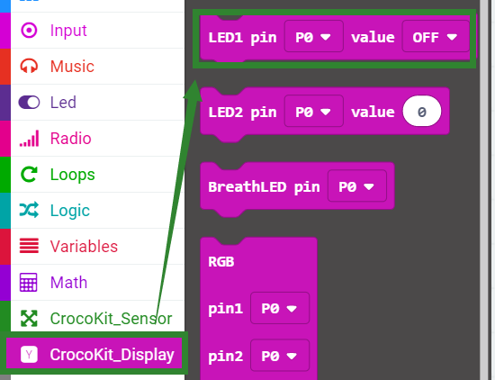
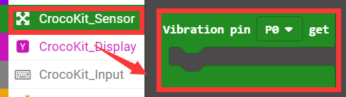
Advanced course
Part 4
Search for blocks
YahBoom Croco:Kit tutorial

Slide 8
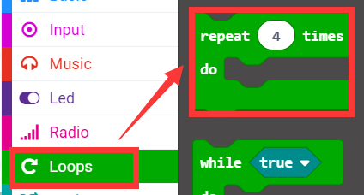
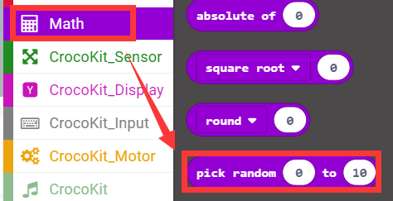
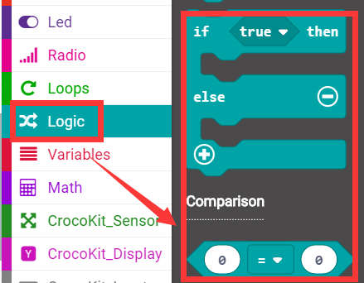
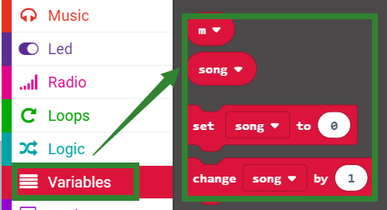
Advanced course
Part 4
Search for blocks
YahBoom Croco:Kit tutorial

Slide 9
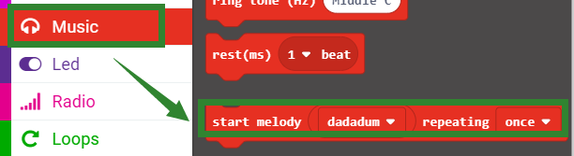
Advanced course
Part 4
Search for blocks
YahBoom Croco:Kit tutorial

Slide 10
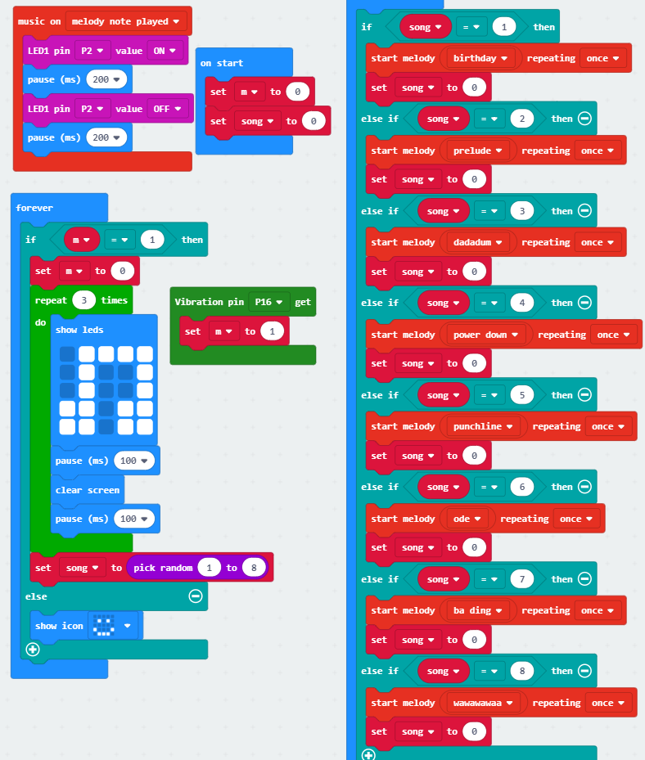
Advanced course
Part 5
Combine blocks
YahBoom Croco:Kit tutorial

Slide 11
Advanced course
Thank you ！
Powered by YahBoom
YahBoom Croco:Kit tutorial

